Slide 1
Word Association with Semantic Memory
Jule Schatz
Undergraduate at University of Michigan
Computer Science
Notes:
More about semantic memory (cog sci)

Slide 2
Agenda
Introduction
Hypothesis
Design
Results
Future work

Slide 3
Motivation
Get familiar with Soar cognitive architecture
Test Soar’s spreading in semantic memory
Create an agent with a real world application
The board game Codenames
RAT - remote association test for creativity
Apply concepts from cognitive psychology

Slide 4
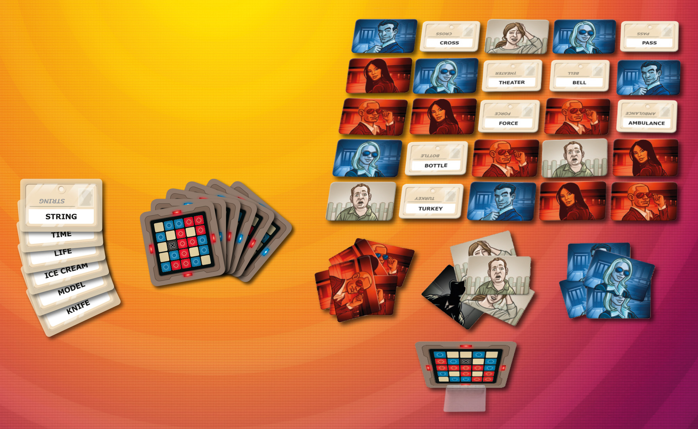
Codenames
Popular word association game
Game has two roles
Clue giver
Guesser
Notes:
Background on code names

Slide 5
Codenames
Popular word association game
Game has two roles
Clue giver
Guesser

Slide 6
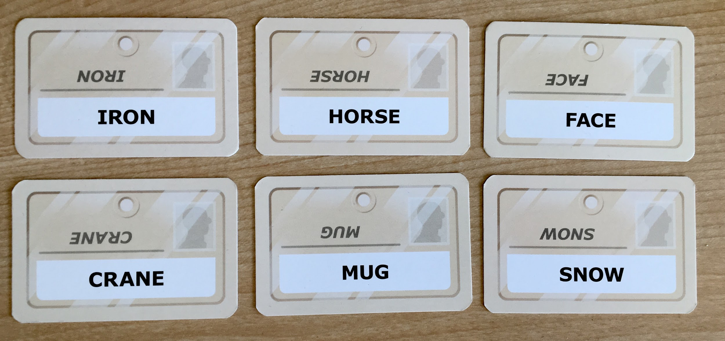
Codenames- simplified guesser
Given a series of board words and a one word clue
Pick the board word that is most associated with the clue
Clue: Animal

Slide 7
Codenames- simplified guesser
Given a series of board words and a one word clue
Pick the board word that is most associated with the clue
Clue: Animal

Slide 8
Hypothesis
Utilize a semantic memory model to create an agent (player) in the Soar cognitive architecture that can effectively play codenames

Slide 9
Semantic Memory
Long term memory that stores facts
The sky is blue
Birds are animals
Does not store experiences or situations

Slide 10
Semantic Memory Model
Words are represented by nodes and can be connected to other nodes (words)
Bird
Canary
Feathers
Ostrich

Slide 11
Semantic Memory Model
Words are represented by nodes and can be connected to other nodes (words)
Words can have varying degrees of associations
Ostrich is less related to bird than Canary
Bird
9
10
Canary
Feathers
3
Ostrich
Notes:
Spreading Activation-

Slide 12
Semantic Memory Model
Words are represented by nodes and can be connected to other nodes (words)
Words can have varying degrees of associations
Ostrich is less related to bird than Canary
Spreading - If you think about a word it activates the words connected to it
Bird
9
10
Canary
10
Feathers
A spreading-activation theory of semantic processing.
Collins, Allan M.; Loftus, Elizabeth F.
Psychological Review, Vol 82(6), Nov 1975, 407-428.http://dx.doi.org/10.1037/0033-295X.82.6.407
pillow
3
8
Ostrich
soft
Notes:
Spreading Activation-

Slide 13
Soar Cognitive Architecture
Create an agent (player) that has access to and can initialize semantic memory
Semantic memory supports
association weights
spreading

Slide 14
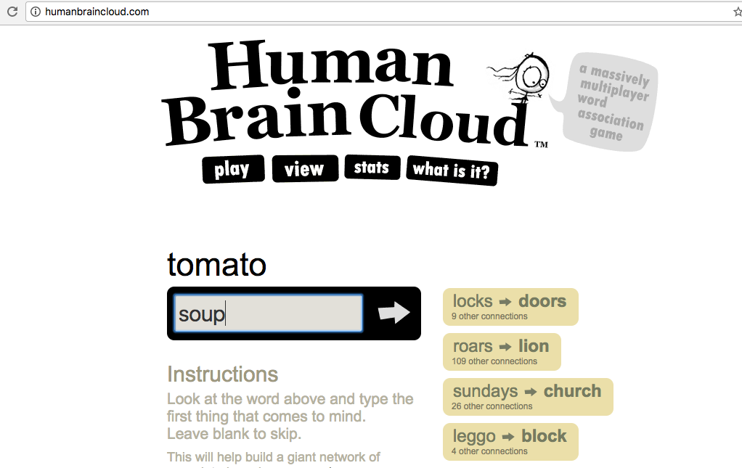
Data set - Human Brain Cloud
Online “game” that crowdsources word associations
Got website’s database
Word1 Word2 Weight
Over 4 million data points
Initialize semantic memory with this data
Special thanks to the creator of Human Brain Cloud, Kyle Gabler

Slide 15
Data set
smem --add {
(<0> ^word volcano)
(<1> ^word fire)
(<0> ^assoc <1> (10.0))
(<1> ^assoc <0> (10.0))
}
^word
0
volcano
^assoc
10.0
^assoc
10.0
1
^word
fire

Slide 16
Data set
smem --add {
(<0> ^word volcano)
(<1> ^word fire)
(<0> ^assoc <1> (10.0))
(<1> ^assoc <0> (10.0))
}
^word
0
volcano
^assoc
10.0
^assoc
10.0
1
^word
fire
~40k unique words
~2.5 million associations

Slide 17
First Agent (player) - Spreading
Spreading adds activation
Activation helps the item be retrieved when querying semantic memory
Notes:
We want only board cards back but them to be ordered by association

Slide 18
First Agent (player) - Spreading
Spreading adds activation
Activation helps the item be retrieved when querying semantic memory
Animal
Dog
30
Spread from clue
While board card is not returned
Query semantic memory
5
Bird
7
Crane
Horse
Notes:
We want only board cards back but them to be ordered by association

Slide 19
First Agent (player) - Spreading
Spreading adds activation
Activation helps the item be retrieved when querying semantic memory
Animal
Dog
30
Spread from clue
While board card is not returned
Query semantic memory
5
Bird
7
Crane
Horse
Notes:
We want only board cards back but them to be ordered by association

Slide 20
First Agent (player) - Spreading
Spreading adds activation
Activation helps the item be retrieved when querying semantic memory
Animal
Dog
30
Spread from clue
While board card is not returned
Query semantic memory
5
Bird
7
Crane
Horse
Notes:
We want only board cards back but them to be ordered by association

Slide 21
First Agent (player) - Spreading
Spreading adds activation
Activation helps the item be retrieved when querying semantic memory
Animal
Dog
30
Spread from clue
While board card is not returned
Query semantic memory
5
Bird
7
It can take hundreds of queries before we return a board card
Crane
Horse
Notes:
We want only board cards back but them to be ordered by association

Slide 22
Base Level Activation
When an item is queried from semantic memory it gets base level activation
Base level activation is related to how frequently and recently the word was queried from semantic memory
Base level activation adds to the overall activation of an item.
Notes:
Base level activation

Slide 23
Final Agent (player) - Spreading + Base Level
Spread from clue
Query board cards
While board card is not returned
Query semantic memory
Animal
Dog
30
5
Bird
7
Crane
Horse
Notes:
Spreading with base level activation

Slide 24
Final Agent (player) - Spreading + Base Level
Spread from clue
Query board cards
While board card is not returned
Query semantic memory
Animal
Dog
30
5
Bird
7
Crane
Horse
Notes:
Spreading with base level activation

Slide 25
Final Agent (player) - Spreading + Base Level
Spread from clue
Query board cards
While board card is not returned
Query semantic memory
Animal
Dog
30
5
Bird
7
Crane
Horse
Notes:
Spreading with base level activation

Slide 26
Final Agent (player) - Spreading + Base Level
Spread from clue
Query board cards
While board card is not returned
Query semantic memory
Animal
Dog
30
5
Bird
Takes tweaking of the base level and spreading activation
7
Crane
Horse
Notes:
Spreading with base level activation

Slide 27
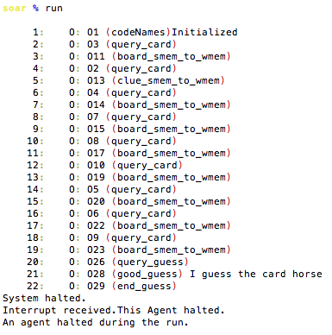
Results
Board: Iron, crane, mug, horse
Clue: animal

Slide 28
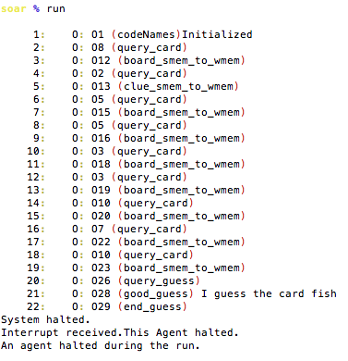
Results
Board: fish, dog, potato, volcano
Clue: scales

Slide 29
Results
Created an agent (player) that can play as a simplified guesser for Codenames
Agent utilizes semantic memory with spreading and base level activation
The agent is limited by the data it has in smem

Slide 30
Future Work
Further evaluate agent
Create clue giver agent

Slide 31
Codenames
Popular word association game
Game has two roles
Clue giver
Guesser

Slide 32
Codenames
Popular word association game
Game has two roles
Clue giver
Guesser

Slide 33
Clue Giver
Given a series of words find a word (clue) that relates the most of the board words
Ex) Animal - relates horse, and crane
Ex) Knight - relates iron, horse, and face

Slide 34
Sub-Goals for Clue Giver
Given two words, find a clue that relates them
Given three words find a clue that relates them
Given three words find a clue between two of the words
Given three words find either a clue between three or two of them
Given a list of words find a clue between the most number of words

Slide 35
Sub-Goals for Clue Giver
Given two words, find a clue that relates them
Given three words find a clue that relates them
Given three words find a clue between two of the words
Given three words find either a clue between three or two of them
Given a list of words find a clue between the most number of words
Codenames

Slide 36
Sub-Goals for Clue Giver
RAT- creativity test
Given two words, find a clue that relates them
Given three words find a clue that relates them
Given three words find a clue between two of the words
Given three words find either a clue between three or two of them
Given a list of words find a clue between the most number of words
Codenames

Slide 37
RAT - remote association test
A creativity test traditionally used to evaluate human creativity potential, published by Mednick and Mednick, 1971

Slide 38
RAT - remote association test
A creativity test traditionally used to evaluate human creativity potential, published by Mednick and Mednick, 1971
Given three words find a clue that relates them

Slide 39
RAT - remote association test
A creativity test traditionally used to evaluate human creativity potential, published by Mednick and Mednick, 1971
Given three words find a clue that relates them
Ex) cream, skate, water
Ex) tank, hill, secret

Slide 40
Related Work
A.-M. Oltet ̧eanu and Z. Falomir, “comRAT-C: A computational compound remote associate test solver based on language data and its comparison to human performance.” Pattern Recognition Letters, vol. 67, pp. 81–90, 2015.

Slide 41
Related Work
A.-M. Oltet ̧eanu and Z. Falomir, “comRAT-C: A computational compound remote associate test solver based on language data and its comparison to human performance.” Pattern Recognition Letters, vol. 67, pp. 81–90, 2015.
E. M. Bowden and M. Jung-Beeman, “Normative data for 144 compound remote associate problems,” Behavior Research Methods, Instruments, & Computers, vol. 35, no. 4, pp. 634–639, 2003

Slide 42
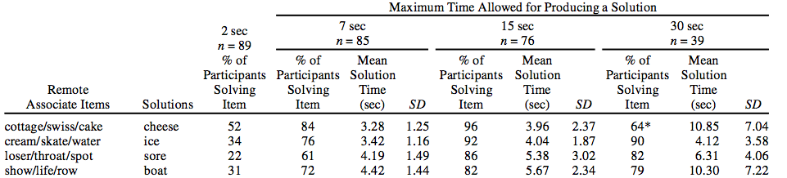
RAT Problem Data Example

Slide 43
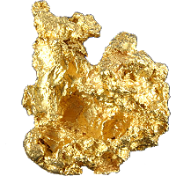
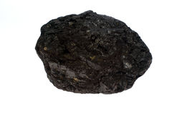
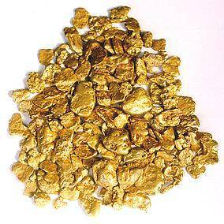
Summary
Created an agent that can pick words given a clue
Limited by data
Plan on creating an agent that can create a clue given cards
In the process create an agent that performs the RAT test
RAT test is well researched
RAT test has data to evaluate my agent

Slide 44
Thank you!
Steven Jones - Graduate Student at University of Michigan
John Laird - Professor at University of Michigan
Kyle Gabler - Freelance Programmer

